Slide 1


Differentiation in Industry
How to differentiate yourself when applying for roles
John McNamara
IBM Master Inventor
UK University Programs Lead
@j0nnymac
j0nnymac@uk.ibm.com

Slide 2

Introductions
John McNamara
IBM – Master Inventor – help people invent
Externally – help people innovate
Academia - Sheffield Hallam University – Visiting Professor
Academia - University of Sheffield – Research Fellow
Academia - UCL – Visiting Professor
Interest in making AI (and tech) simple
Interest in the above started with comics

Slide 3
Before we Begin ☺
First – go here:
https://www.ibm.com/academic/home
Register & Log in with academic email
-use Chrome in Incognito mode-
Find ‘Capstone’ section
Spend 10 mins – open and review the FOUR Getting Started Badges
Open up each Badge and bookmark each badge for later

Slide 4
What am I going to be talking about?
How to differentiate yourself when exploring careers in industry
Recommended
Spend time sourcing industry credentials/accreditations (IBM has free ones)
Relatively few students have these – spending a couple of hours will pay real dividends
Download and play with Enterprise Tools and learn and apply industry methods (Design Thinking)
We offer access to the IBM catalogue of enterprise software free and access to methods
CREATE SOMETHING
If you are technical – create an app that solves a problem
If you are more business focused – show how you volunteered to help
a local charity/business/society using your new skills (eg Design Thinking)

Slide 5
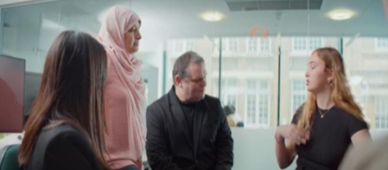
Rapid Innovation Projects
Assistive communication enhancement
Verbal communication difficulties effect millions
Current assistive technologies can be slow & ‘canned’
Watson application to:
Help the user communicate naturally around a range of topics
Help the user respond within a natural time frame
Turned the idea of a ‘chatbot’ on its head…
We used:
Watson TtS & StT API’s
Watson Assistant
Watson Discovery
Watson Tone Analyser
Project ACE

Slide 6
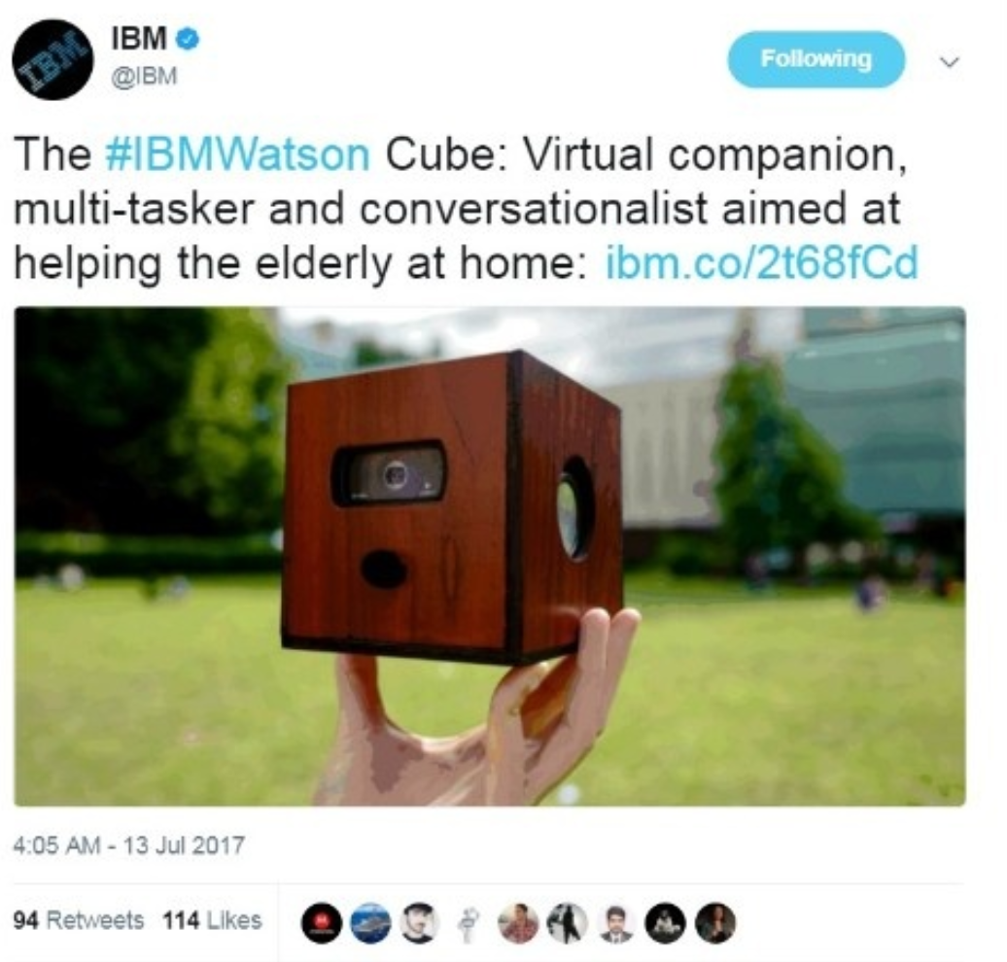
Rapid Innovation Projects
Independent Living Project
Internet technologies can seem overwhelming. Very often to those people who need them the most.
Watson device to:
-Detect when user was present
-Monitor routine
-Encourage journal
-Provide window to social comms
-Access to digital entertainment
Used:
Watson TtS & StT API’s
Watson Assistant
Watson Discovery
Watson Visual Recognition
Watson Tone Analyser
NodeRED
Project Cube

Slide 7
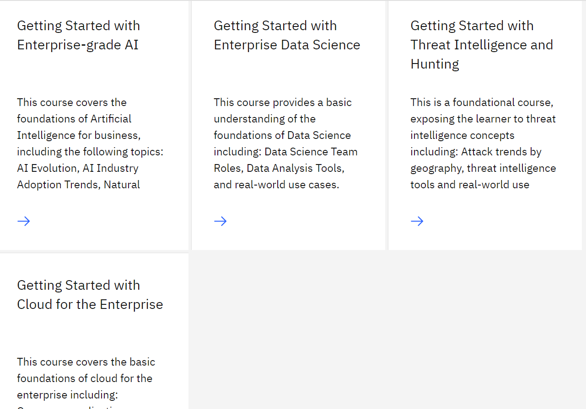
Review the following badges
Review the following badges on this page - https://www.ibm.com/academic/topic/capstone
(ensure you are logged in)
2. With these badges you can start to create these types of projects

Slide 8
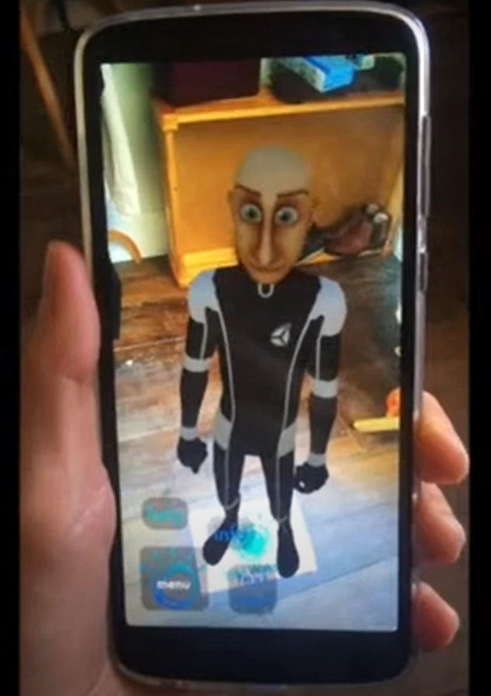
Rapid Innovation Projects
Augmented Reality A.I Assistant
In the NHS many highly qualified people can have their time taken up with low value tasks that can put them at risk
Watson application to:
-Interact with a user naturally
-Provide directions
-Answer simple queries
Used:
Watson TtS & StT API’s
Watson Assistant
NodeRED
Project AURA

Slide 9
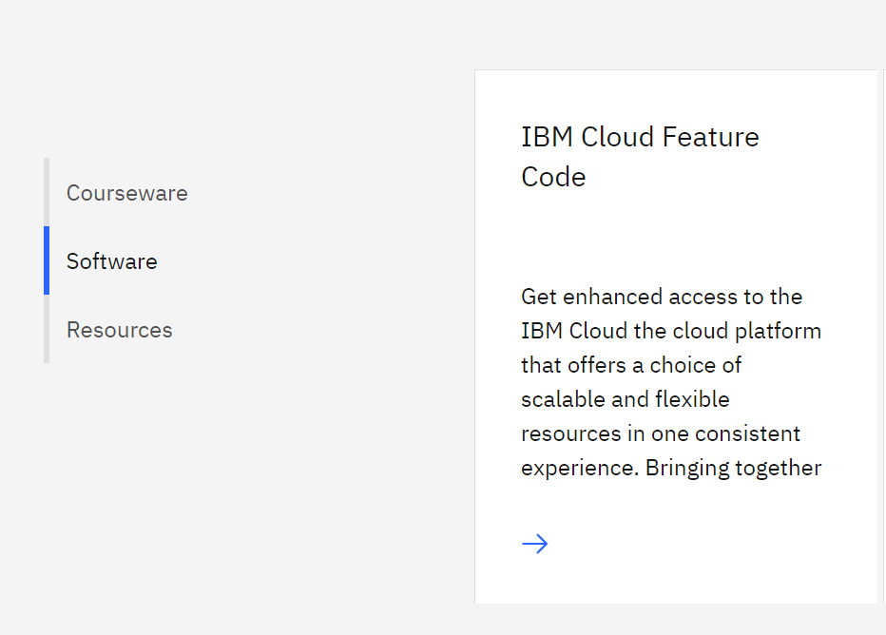

Obtain your free Cloud access
Obtain an IBM Cloud Voucher Code - https://www.ibm.com/academic/topic/cloud
(ensure you are logged in)

Slide 10
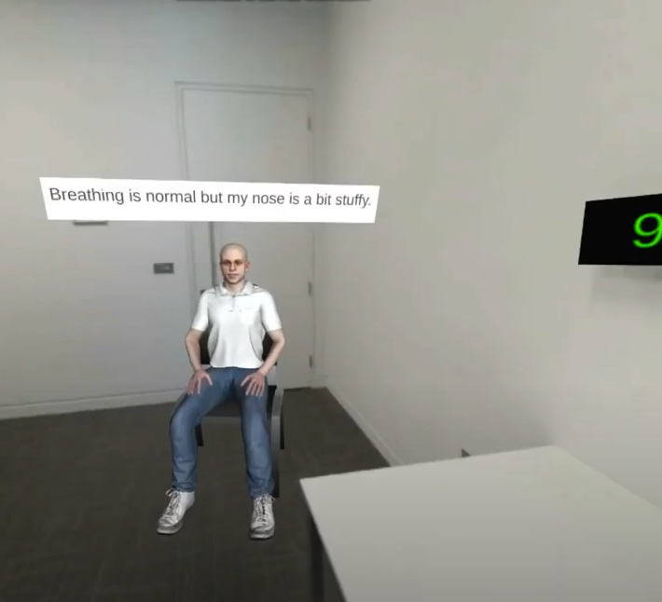
Rapid Innovation Projects
RCGP – AI/VR Training Tool for Clinical Assessments
How can we help G.P’s train and prepare for Clinical Assessment?
Watson VR application to:
-Role play a clinical scenario as a patient
-Give symptoms
-Answer questions posed by GP in training
-Provide a clinical assessment environment
Used:
Watson & StT API’s
Watson Assistant
NodeRED
Unity

Slide 11
Bringing it all Together
IBM Design Thinking
https://www.ibm.com/academic/home
Register & Log in with academic email
-use Chrome in Incognito mode-
Find ‘Capstone’ section
Open the Resource tab on the left of the page – and open up the EDT (IBM Enterprise Design Thinking Practitioner Badge)
Doesn’t take long to complete, looks great on a CV/LinkedIn and SO USEFUL

Slide 12
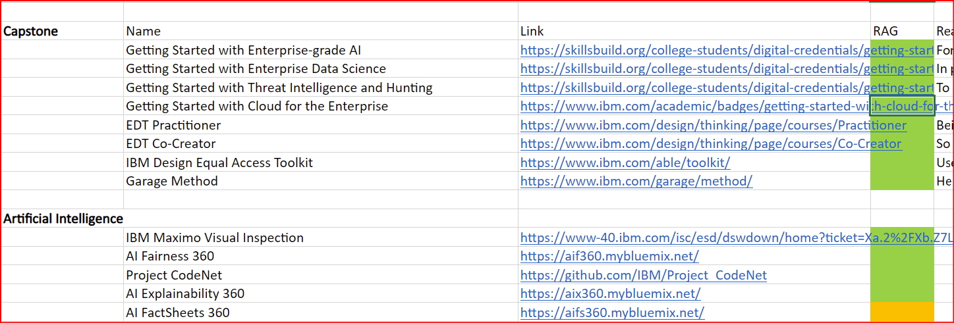
Create a Learning Journal
A simple spreadsheet
https://www.ibm.com/academic/home
As you find learning material – jot down the link and RAG it (RAG?)

Slide 13
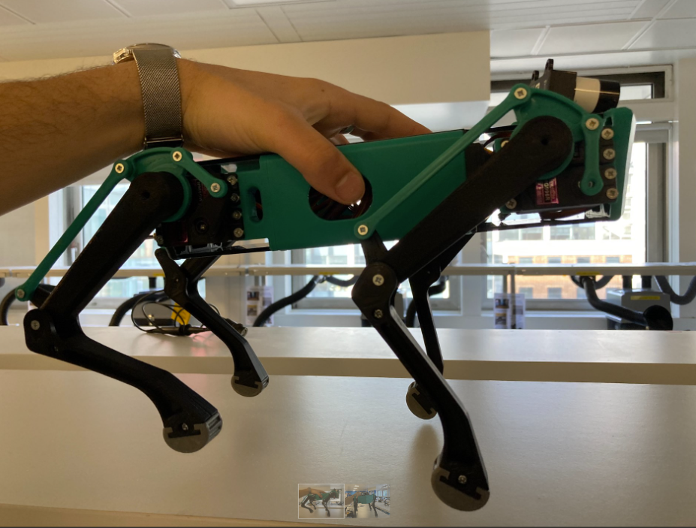
Technical and business work together
“K-9” to support the elderly
We are collaborating on the creation of an AI Pet
For use by elderly
Encourage movement and support mobility
Encourage the keeping of a daily log
Provide access to digital services
Podcasts
Music
News
Monitoring of routine
Has the user stepped out of a routine ?
Is it a cause for concern?
Communicates via Watson
Text to Speech
“I want a pat on the head”
“Are you ok?”
Speech to Text
“Remind me to put the bin out”

Slide 14
Mentorship
IBM has a free mentorship program
This can help give you an insight into IBM
If interested I can work with faculty member to arrange.
Please work through your university Mentorship program

Slide 15
11th October Event
IBM Consultancy
https://tinyurl.com/27gx7c6a
Important to understand
IBM Design Thinking
Appreciation of IBM Cloud, Watson, Security Data Science
How IBM Business & Technical can work together with client to solve problems

Slide 16
Next
Register for the 11th October Career in Consultancy online event
https://tinyurl.com/27gx7c6a
Register your interest in a Graduate career in IBM here
https://www.ibm.com/uk-en/employment/graduate/

Slide 17
Thank you!
John McNamara
@j0nnymac
j0nnymac@uk.ibm.com

Slide 18
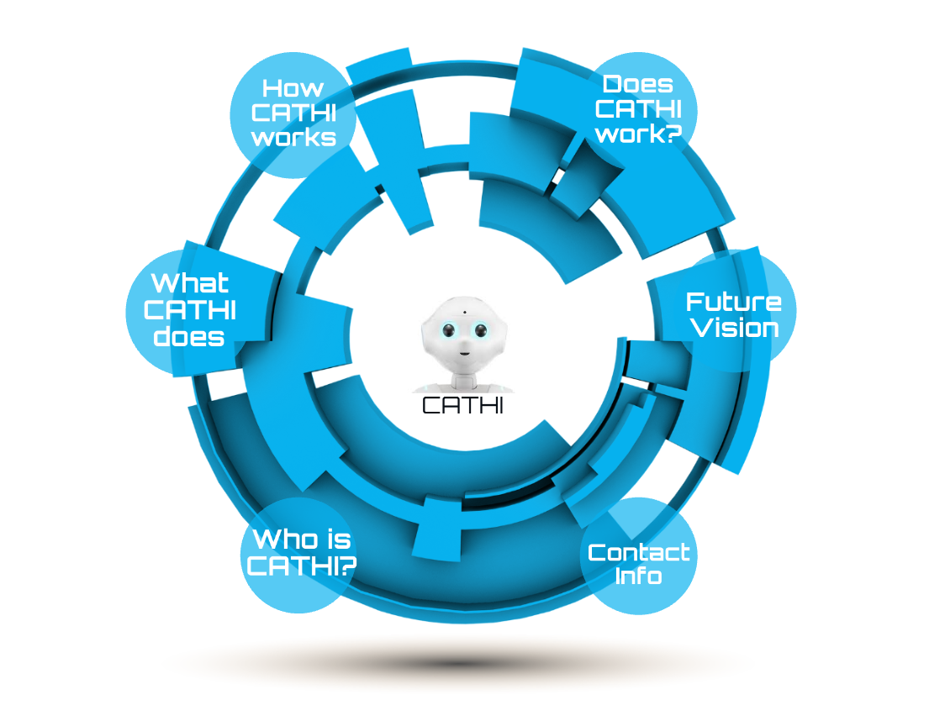
Next
Lots of current projects with the NHS around AI
Movement Therapy
Volunteer Coach Matching System
NHS England Services Chatbot
And something else which might be interesting..
CATHI
https://blogs.shu.ac.uk/shurobotics/cognitive-assessment-through-human-robot-interaction-cathi/

